Slide 1
Pattern Recognition
期中報告
M10517035
蔡龍佑

Slide 2
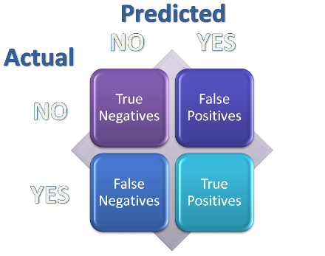
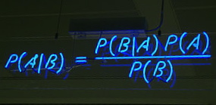



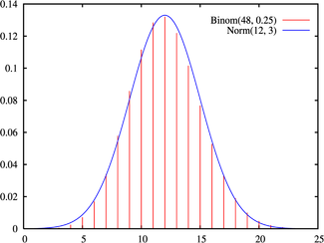
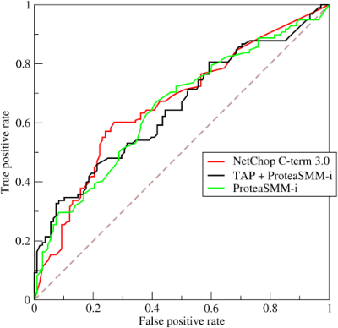


運作流程示意圖
Confusion Matrix
Player
ThrowCoins
Plot Chart

Slide 3
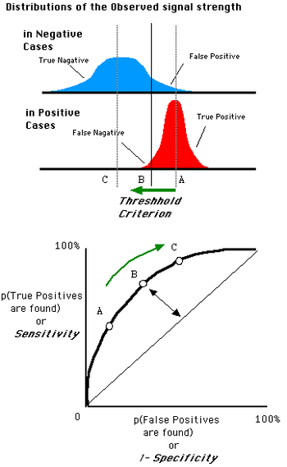
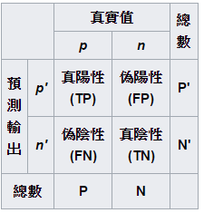
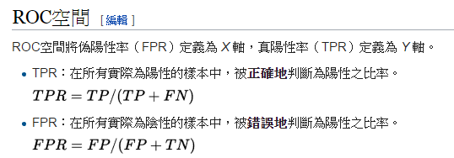
評估指標說明
Confusion Matrix
Receiver Operating Characteristic Curve, ROC Curve
https://zh.wikipedia.org/wiki/ROC%E6%9B%B2%E7%BA%BF

Slide 4
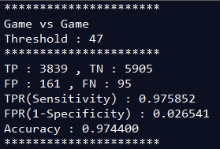
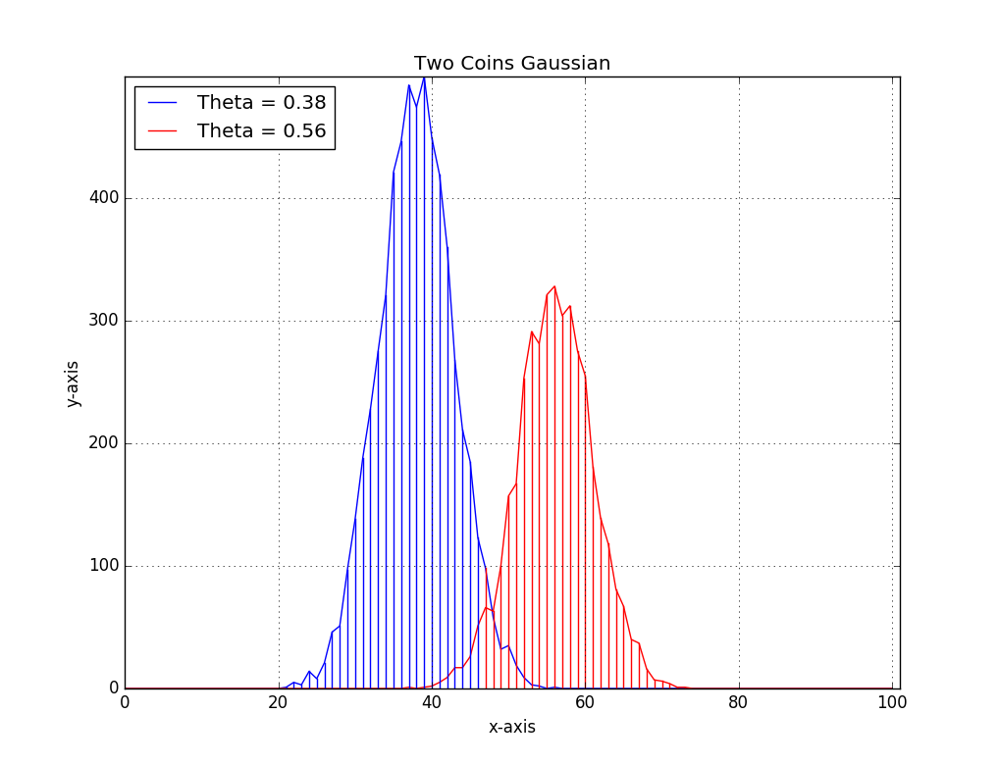
Example 1
Confusion Matrix
TP 3839
TN
5905
FP
161
FN
95
TPR(Sensitivity) : 0.975852
FPR(1-Specificity) : 0.026541
Accuracy : 0.974400

Slide 5
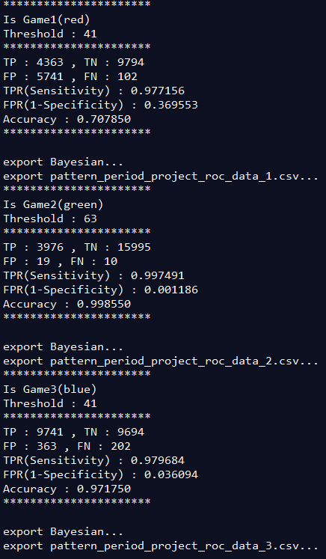
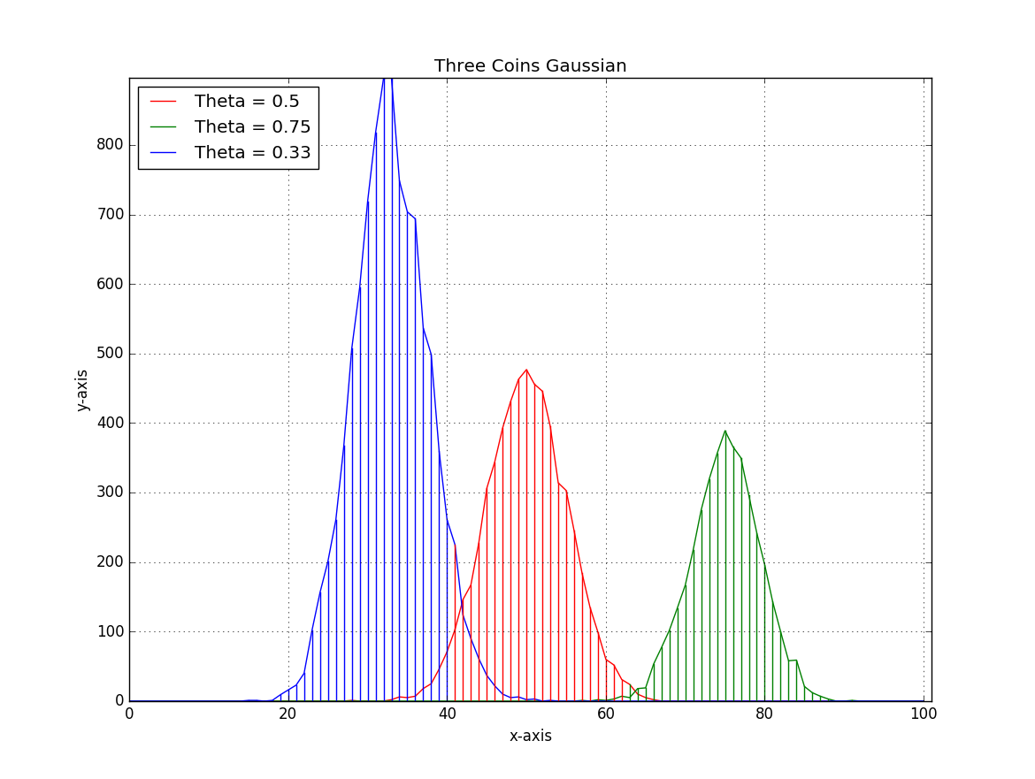
Example 2

Slide 6
Example 2
1
2
3
Threshold : 41
Threshold : 63
Threshold : 41
Confusion Matrix
Confusion Matrix
Confusion Matrix
TP 4363
TN
9794
TP 3976
TN
15995
TP 9741
TN
9694
FP
5741
FN
102
FP
19
FN
10
FP
363
FN
202
TPR(Sensitivity) : 0.977156
FPR(1-Specificity) : 0.369553
Accuracy : 0.707850
TPR(Sensitivity) : 0.997491
FPR(1-Specificity) : 0.001186
Accuracy : 0.998550
TPR(Sensitivity) : 0.979684
FPR(1-Specificity) : 0.036094
Accuracy : 0.971750

Slide 7
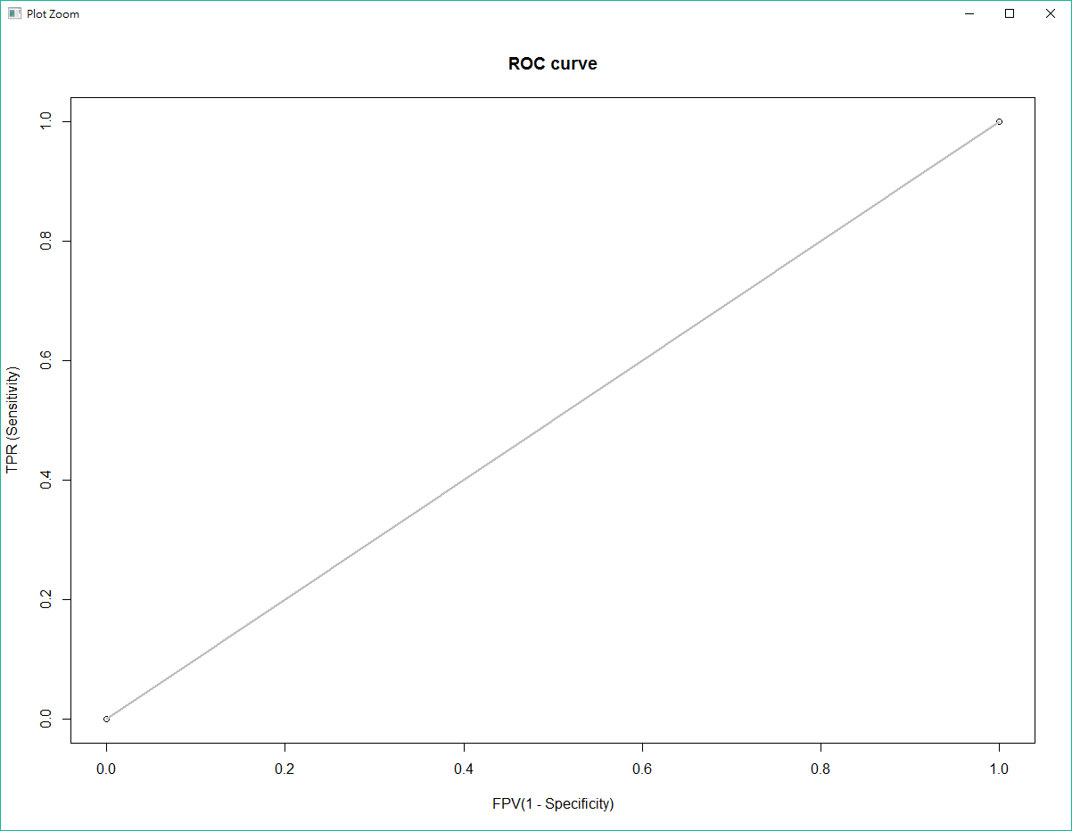
Base Line

Slide 8
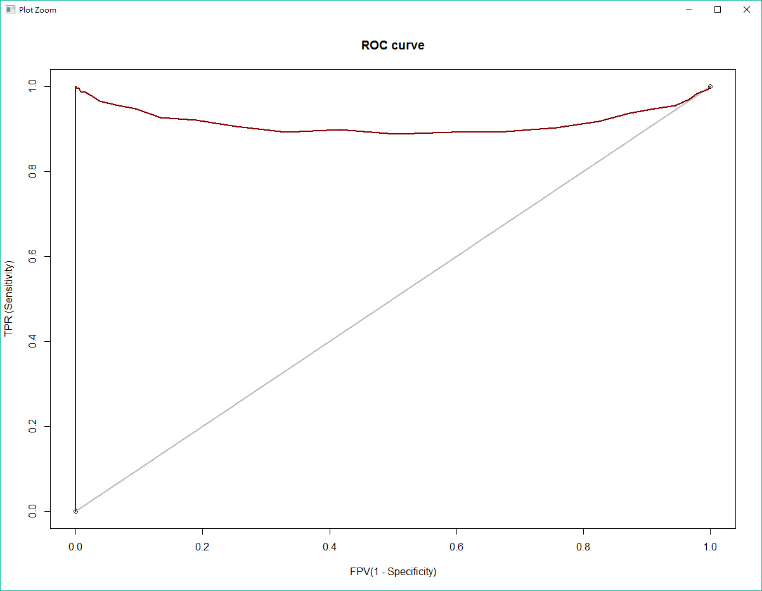
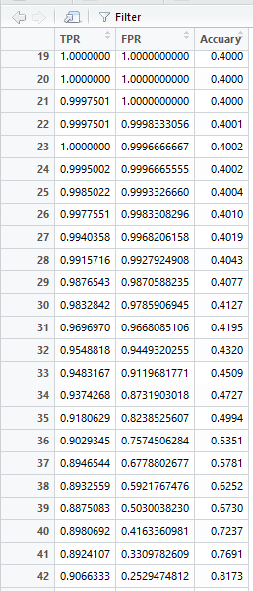
2 Coins

Slide 9
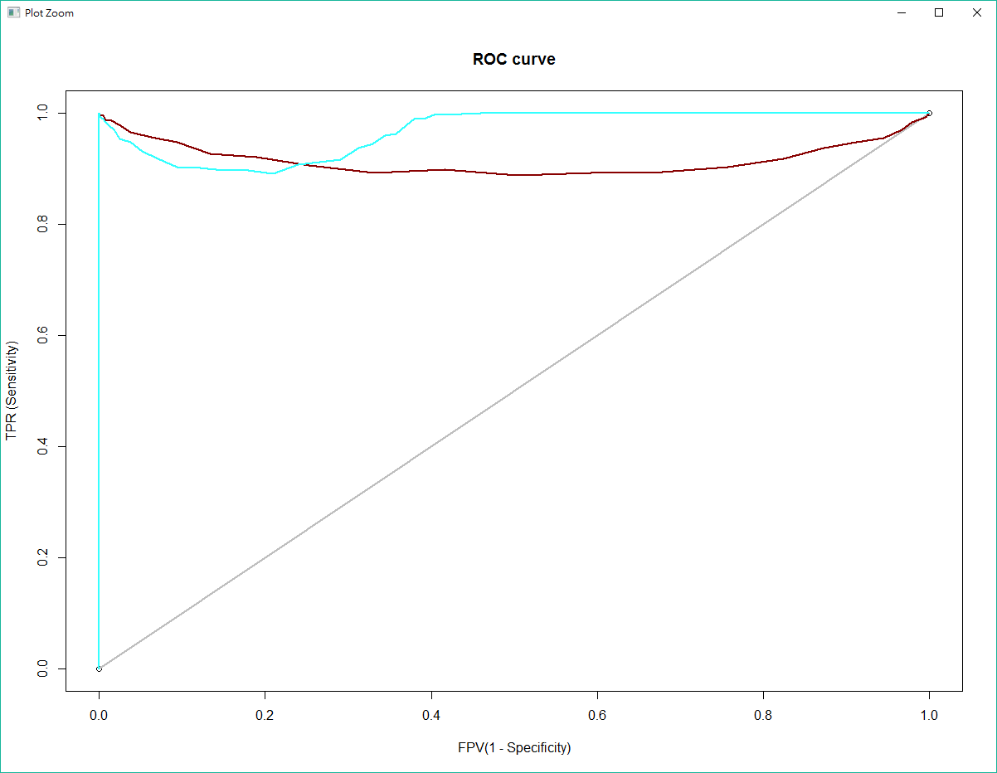
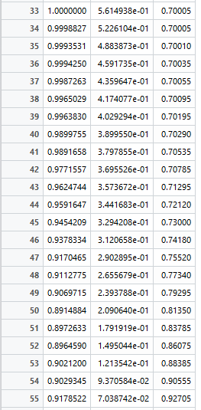
3 Coins theta =0.5

Slide 10
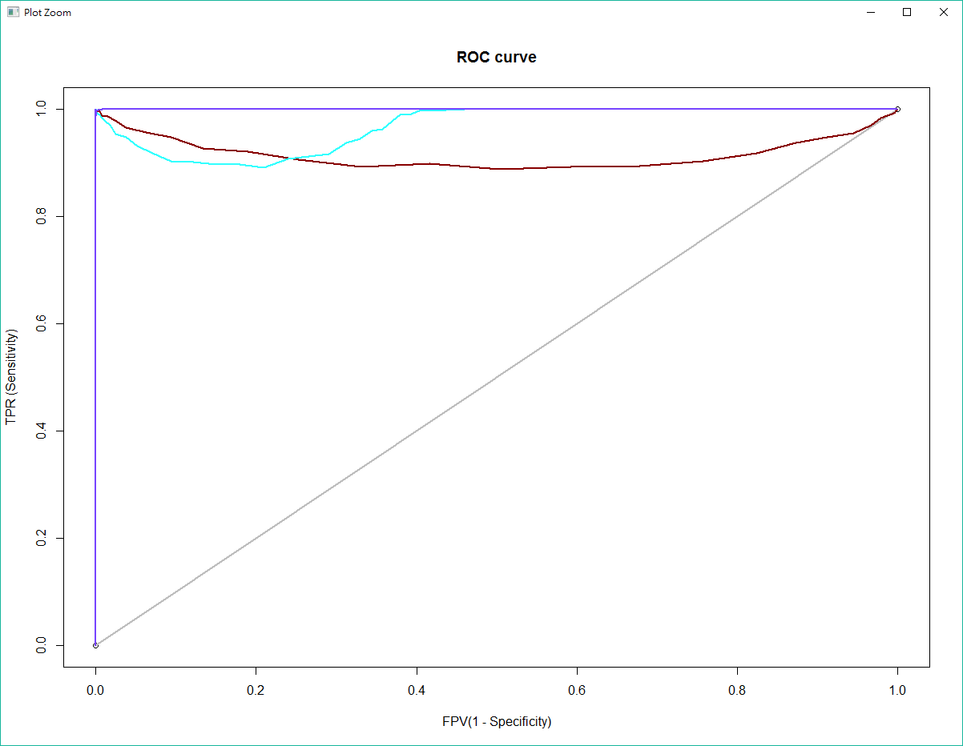
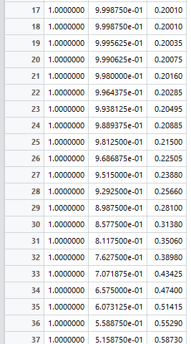
3 Coins theta =0.75

Slide 11
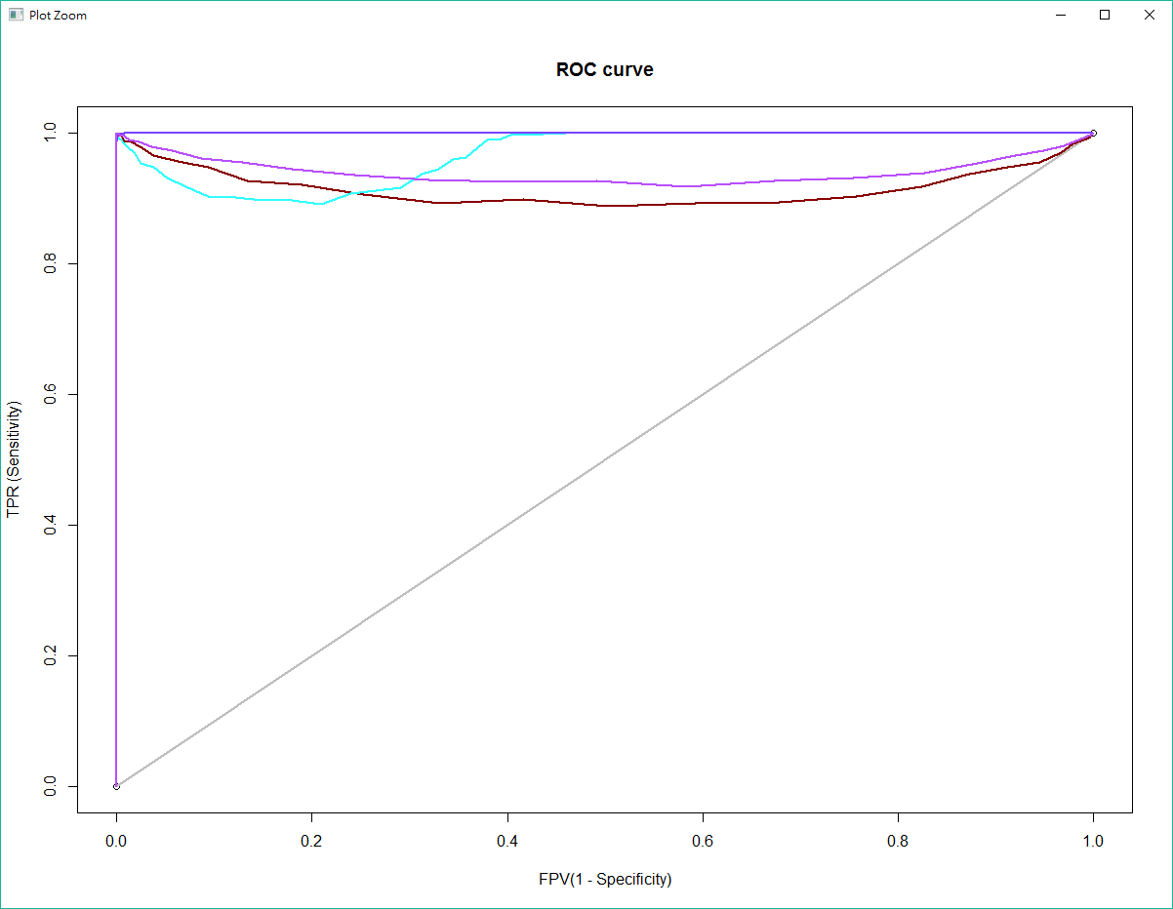
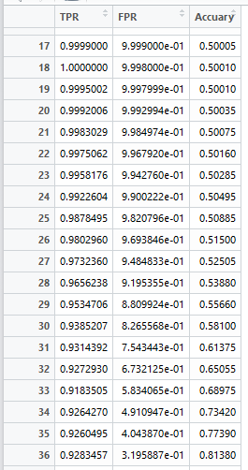
3 Coins theta =0.33

Slide 12
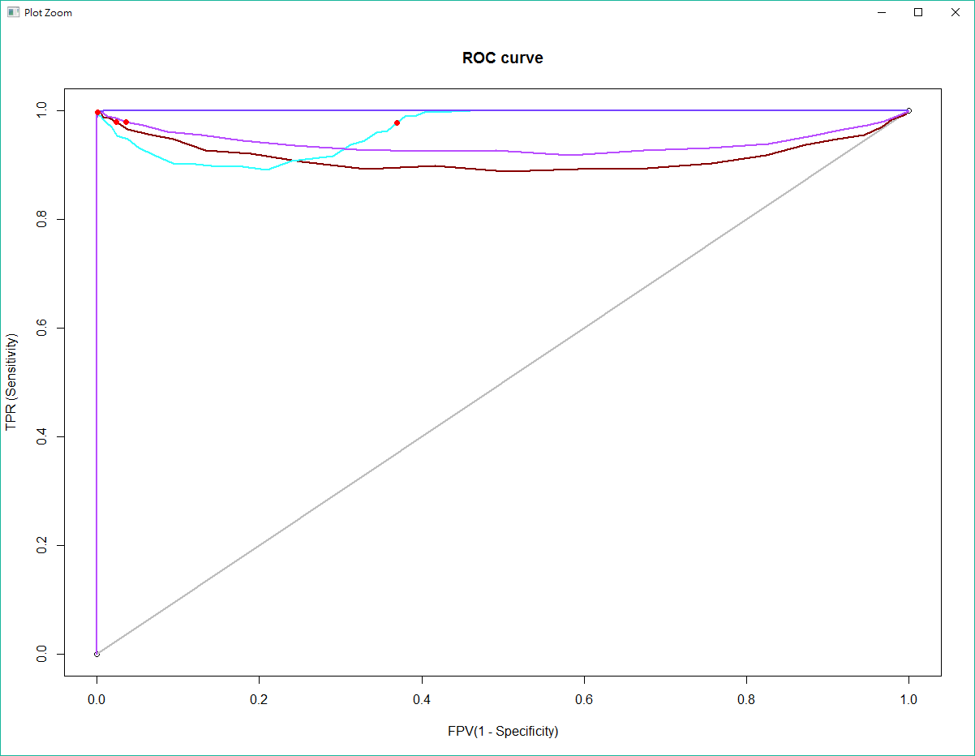
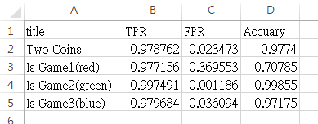

Slide 13
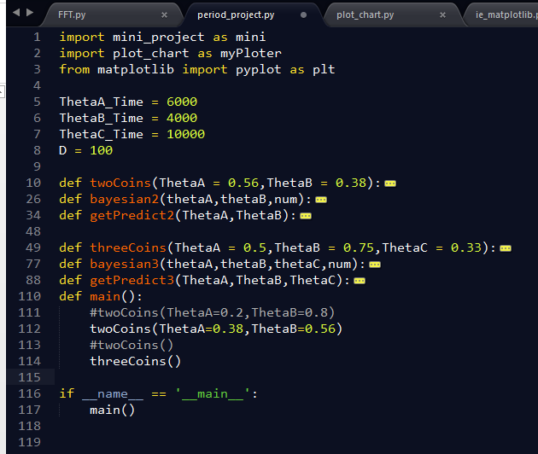
Code
Case 1
Case 2

Slide 14

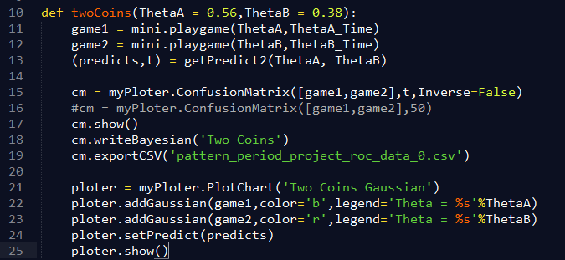


Code
模擬丟硬幣行為

Slide 15
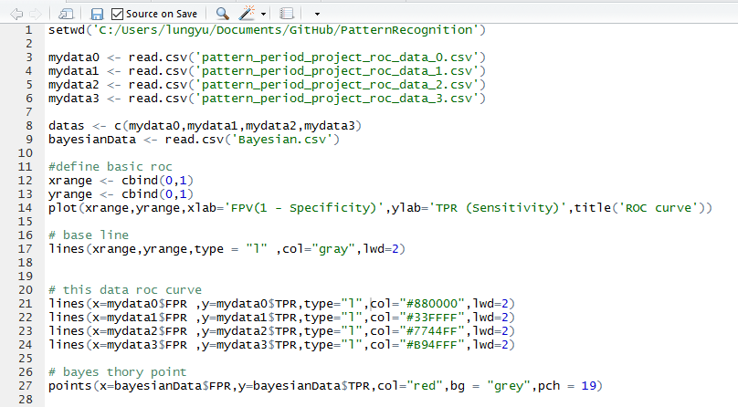
Code
讀取資料
ROC 框框
ROC
貝氏 -> threshold

Slide 16
conclusion
在已知各資料的高斯分布的情況底下，貝氏推論有相當不錯的表現。
Source Code : https://github.com/Lung-Yu/PatternRecognition/

